Slide 1



Green Leaf
Prepared by: Vijay Vaghela-19125059
Gautam Shah-19125060
In_House_Project_Review-2

Slide 2
Task-1: SDLC Model
We are using Waterfall model in our E-commerce website.
Waterfall methodology or Waterfall development cycle is known as the traditional development technique. It generally focuses on planning the project thoroughly and outlines out all of the specific steps like a waterfall.
Everything you require done flows above and spills into the project until everything’s been coded, then you call it done.
During the first stage, steps and operations are determined for the whole project, and the choices are frozen. There is no flexibility for making changes, although it always does.

Slide 3
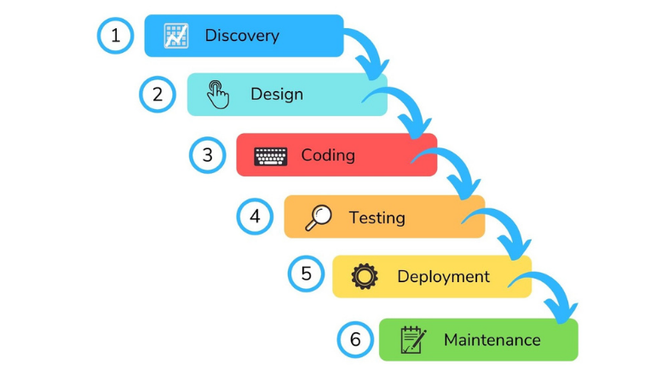
Waterfall Model

Slide 4
Why we choose this waterfall model
While creating an e-commerce website, the waterfall methodology acts as an in-house process and does not need much client participation.
It is a sequential process, but the agile method is a cooperative eCommerce website development process that results in better team input and faster problem-solving.
The waterfall methodology is a kind of perfect project with simply defined requirements and where no modifications are anticipated.

Slide 5
Literature Survey
Zomato
Spice Box
My Dabba Food

Slide 6
Zomato
Zomato initially named as Foodiebay was started in 2008 by Mr. Deepinder Goyal. It is a restaurant searching platform providing in-depth details with autonomous reviews and ratings. Foodie bay, the initial name was changed to Zomato in November 2010 to increase their reach among people.
To make home made Tiffin easily available to users and tracking the vendor for delivery.
Useful for college students, hostel residents and employees. As the application will provide a platform for ordering a home-made meal on the go.

Slide 7
SpiceBox
Name – SpiceBox
Location – Mumbai and Navi-Mumbai.
Working –
This program provides vegetarian and vegetarian diets to users (customers). Provides other veg / non-veg diet dates. SpiceBox also offers a discounted price, if one offers tiffin orders for food for a period of days
Limits –
Do not give different foods every week.
It is not easy to use.

Slide 8
My Dabba Food
Name - My Dabba Food
Location - Provided in various locations in India.
Working - This website provides Tiffin services in various locations in India. The organization's plan is to provide a Tiffin Center location for local users / markers. It shows the location of the Tiffin Center near his place.
Benefits -
A customer (Tiffin supplier) can easily grow his business in his area.

Slide 9
Business Drivers
Thus the online retail business can deliver more advanced services faster because of three main factors: scalability, intricacy, and velocity – which are crucial key drivers of ecommerce.

Slide 10
Business Model
In E-Commerce, there are five different B2C business models: direct sellers, online intermediaries, advertising-based, community-based, and fee-based. Direct selling is the most common model. It is when consumers buy products from online retailers.
Business-to-Business (B2B) Business-to-Consumer (B2C) Consumer-to-Consumer (C2C) Consumer-to-Business (C2B)

Slide 11
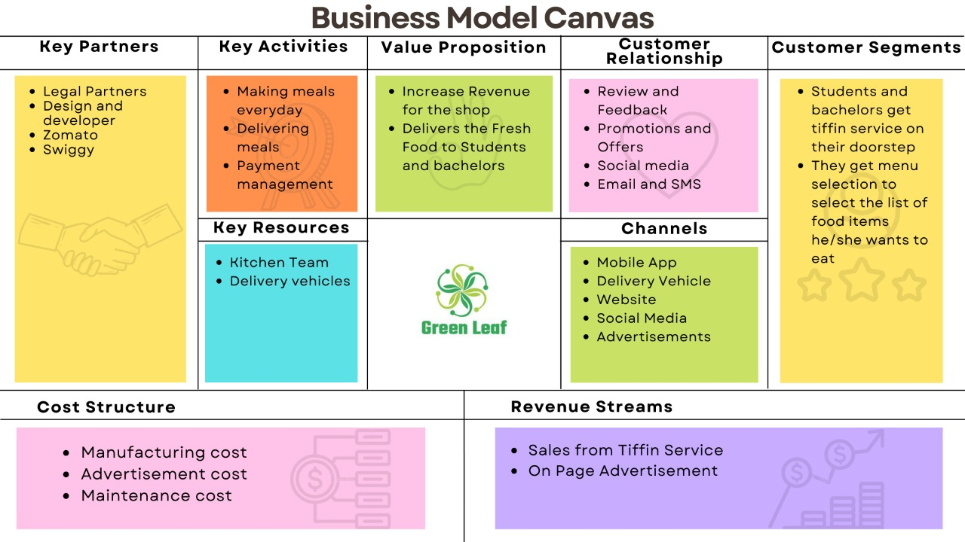

Slide 12
Functional and System Requirements
Functional Requirements:
Mobile-friendliness.
Unique, recognizable design.
Shipping & payment systems integration.
Live chat.
System Requirements:
Fast, stable & secure web hosting.
Highly-responsive mobile site.
User-friendly web design.
Fast checkout process.

Slide 13
Technical Requirements
Fast, stable & secure web hosting. ...
Highly-responsive mobile site. ...
User-friendly web design. ...
Robust operation systems. ...
Fast checkout process. ...
Transparent brand information pages. ...
SEO-friendly web pages. ...
Smooth sales channels integration.

Slide 14
System Qualities
Content management capabilities.
Promotion & discount code tools.
An easy-to-use checkout.
SEO friendly code and layout.
Advanced E-Commerce SEO capabilities.
Reporting tools & custom report features.
An integrated blog or articles section.

Slide 15
Constraints and assumptions
Constraints:
The most frequently cited challenges to e-commerce, among firms with no online sales, include the cost together with uncertainty about return on investment. These firms also often mentioned inadequate connectivity and information technology (IT) infrastructure as substantial hurdles.
Assumptions:
Target Relevant Market.
Improved Brand & Product Awareness.
Simple Global Coverage.
Increased Customer Retention.
International Exposure.
Economical Business Solution.

Slide 16
Acceptance Criteria
The Acceptance Criteria Search for a product by name or category. View products by category. View images and details for each product. Add to cart from the detail or search pages.

Slide 17
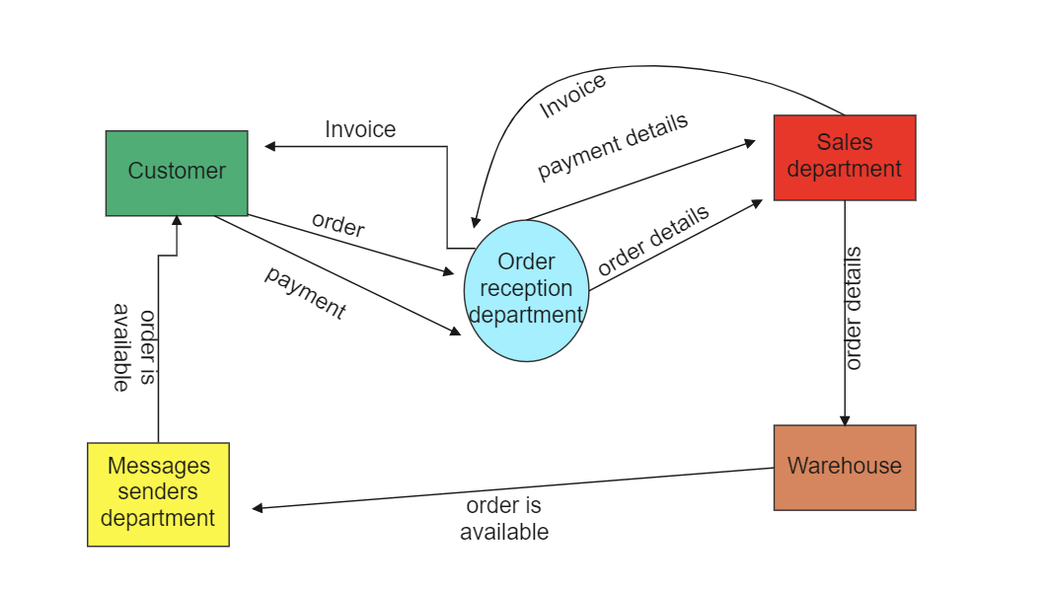
Task-2: Context Diagram

Slide 18
Task-3: UML Diagrams
We have created a Use case Diagram, ER- diagram, Class diagram, Object diagram, Activity diagram and a Sequence diagram for our service that we are modelling.

Slide 19
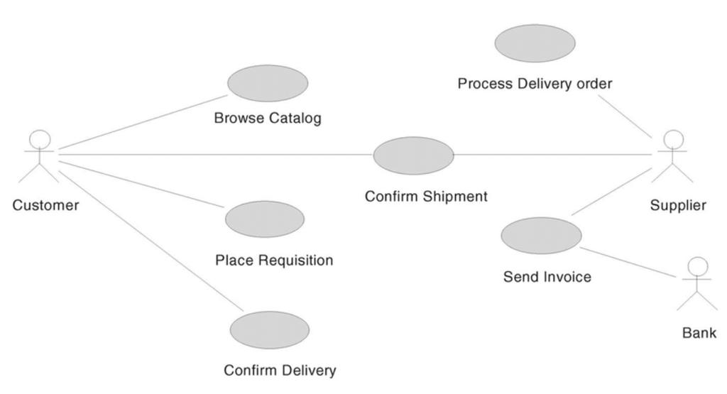
Use-Case Diagram

Slide 20
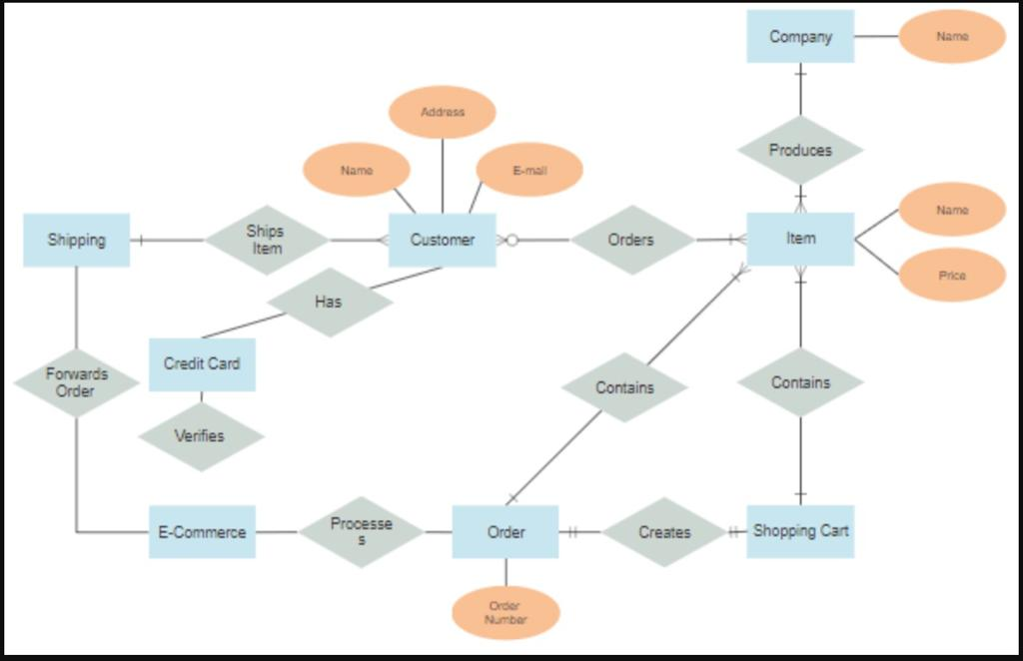
ER Diagram

Slide 21
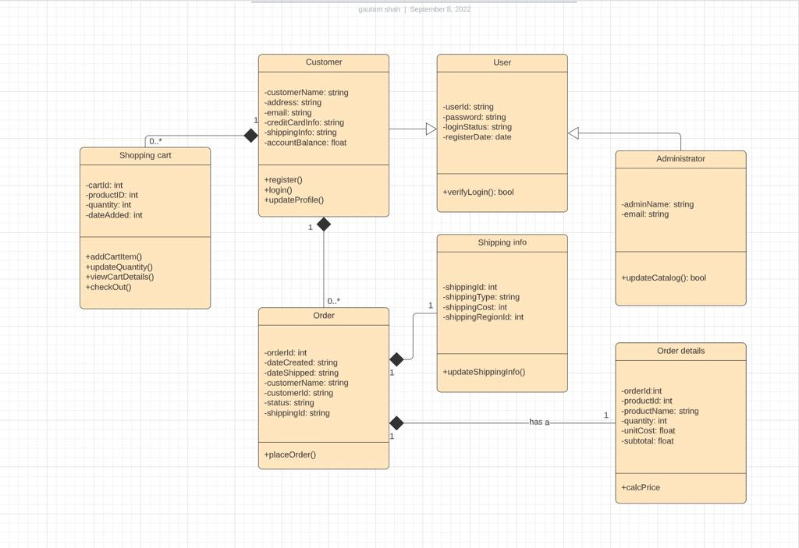
Class Diagram

Slide 22
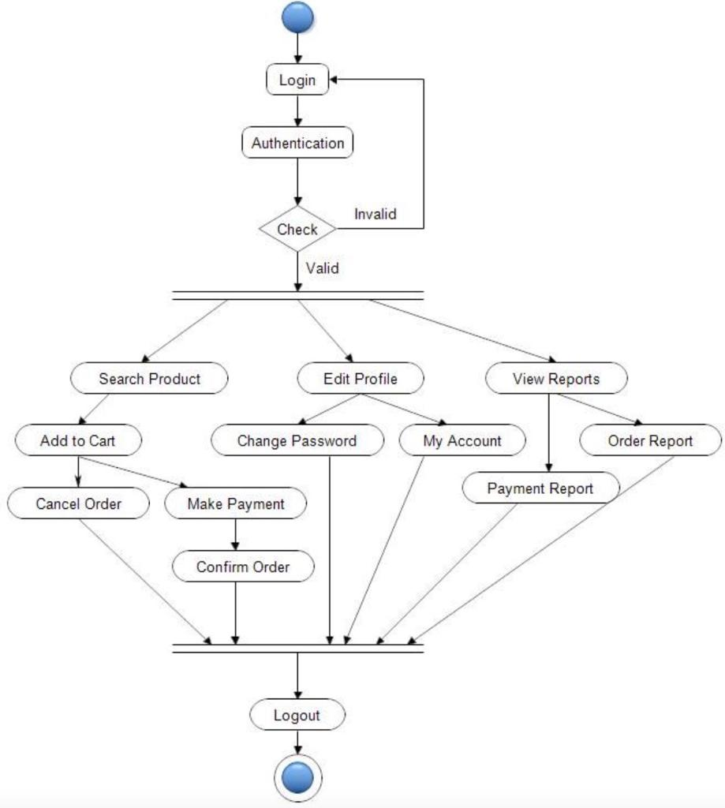
Activity Diagram

Slide 23
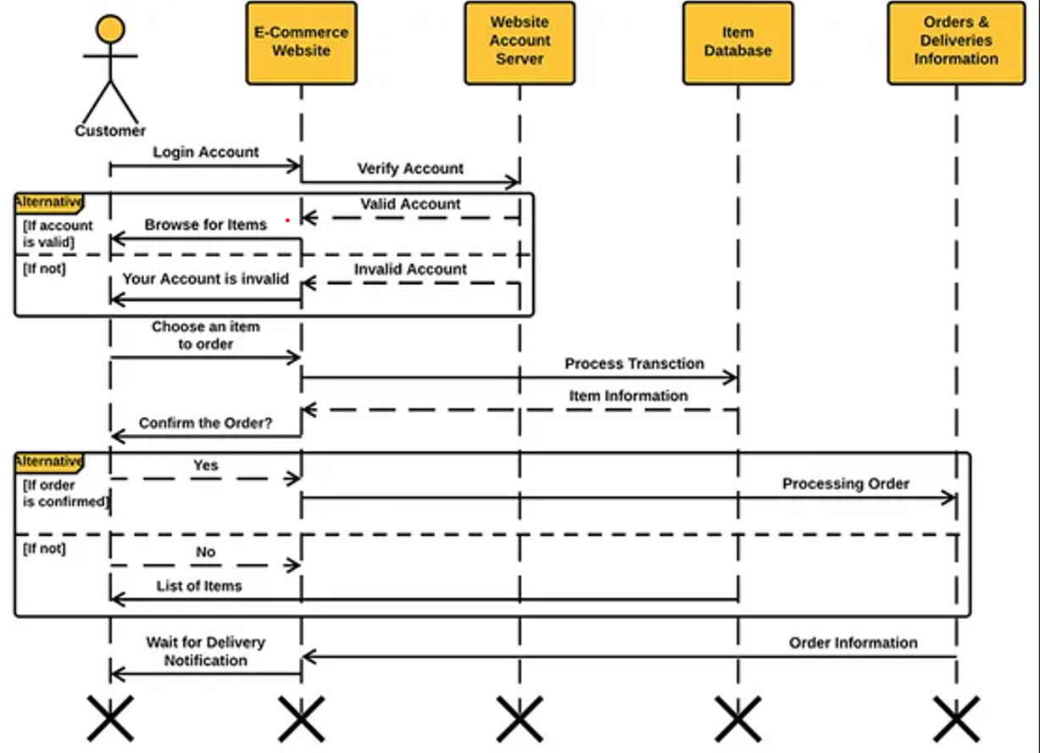
Sequence Diagram

Slide 24
Future Scope
In future enhancement we are going to implement a application for this eCommerce website.

Slide 25
Past Suggestions of Review-1
Review1
1. Create an Business Model.
2. Create an Application along with Website.
Applied Suggestion made
1. Created an Business model for our Service.
2. To create an application takes to much time so we have decided if we get some vacant time then we will be implementing the app for our service.

Slide 26
Conclusion
The UML Diagrams works together to achieve the most desired functions of the E-Commerce Website Project. All of these were designed to guide programmers and beginners about the behavior and structure of E-Commerce Website.
For your official eCommerce website development, both of the methods can mutually be useful. Of course, agile is more popular because of its flexibility and the many different benefits clients get from it.

Slide 27
Thank You

